Slide 1
Schoolusername@bluecoatbeechdale.co.uk
Teams log in details
School password

Slide 2
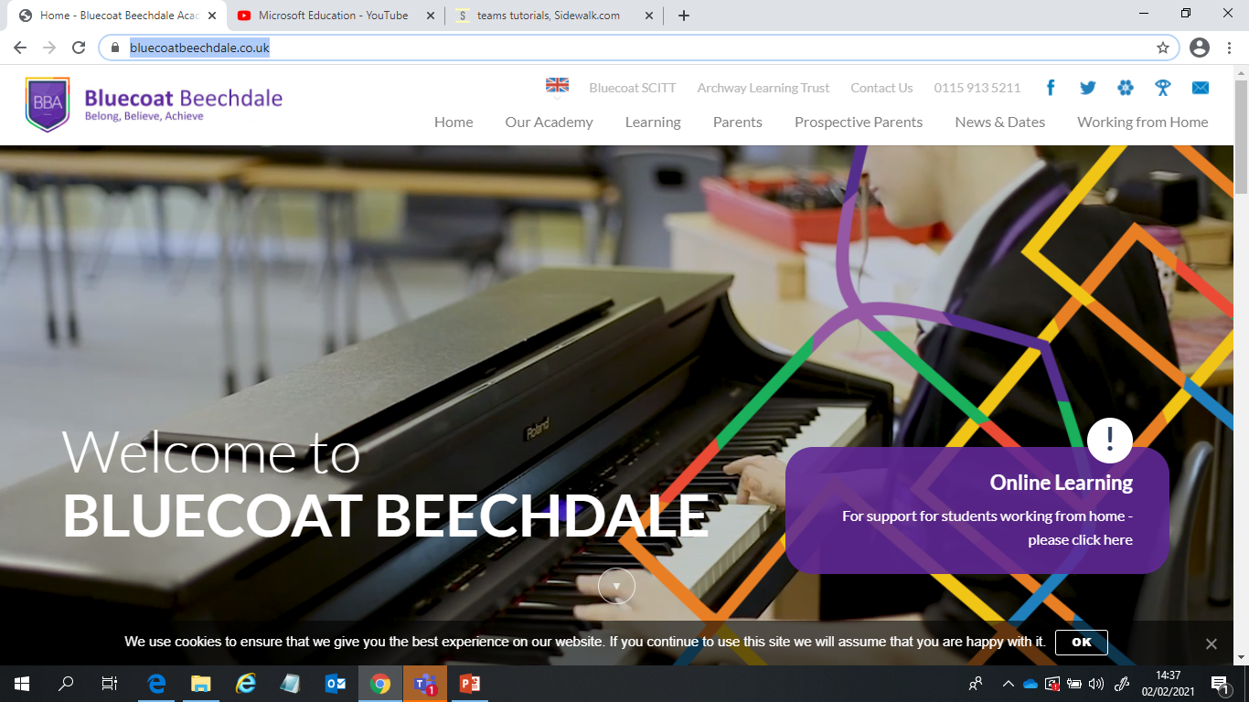
Teams for beginners
Microsoft education YouTube channel
https://www.youtube.com/channel/UCG_FV4WjnZqtm6sux2g069Q
Easy access log on through Microsoft office suite
https://www.bluecoatbeechdale.co.uk/
How to log on and access channels
https://www.youtube.com/watch?v=qx8xHpRMFHU
Clicking on the envelope takes you to Microsoft log in area. Use your school email and password. From this page you will be able to access the full suite of Microsoft applications including Teams.
How to upload a photo to an assignment
https://www.youtube.com/watch?v=Y7NBMOZgK1w
Use the paper clip to attach work in documents

Slide 3
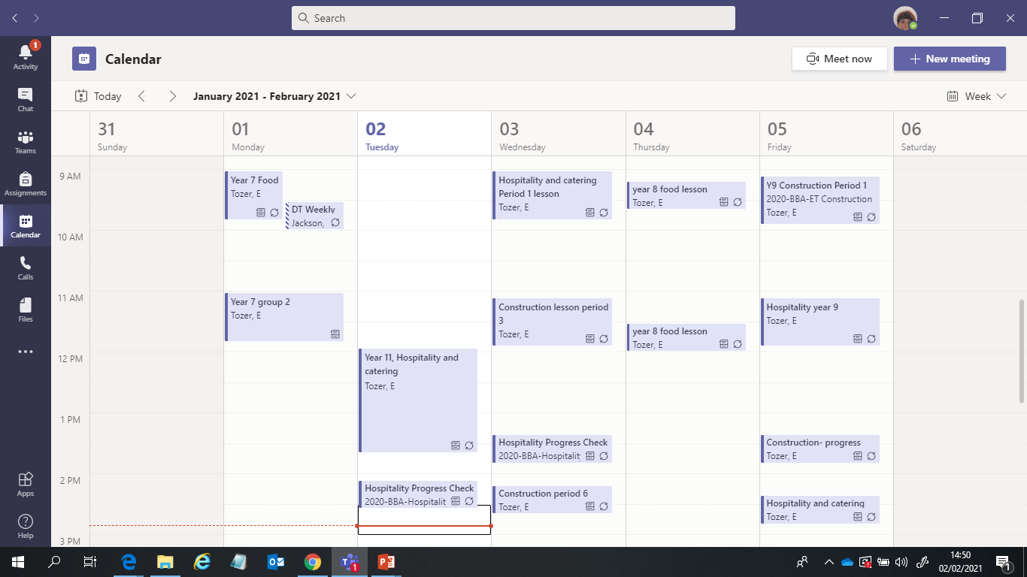
My time table - Click on the blue boxes to join the lessons
Notifications of Assignments
Channels
Assignments
Timetable

Slide 4
Teams for beginners – Immersive Reader
Immersive Reader is a tool on Teams that helps pupils to access their learning. Amongst its functions are:
Text read aloud
Change font size,
Change background colour of PowerPoint slides.
There are other functions too that can help pupils to engage more successfully with their online learning.
The YouTube link below is to a simple step by step guide of how to access Immersive Reader. https://www.youtube.com/watch?v=GIRVT4jiS9g
The following link is to Microsoft’s guidance on how to make the most of Immersive Reader.
https://www.microsoft.com/en-gb/education/products/learning-tools

